Slide 1
System Software
18ESC108A Elements of Computer Science and Engineering
B. Tech. 2018
Ami Rai E.
Roopa G
Chaitra S
Department of Computer Science and Engineering
Faculty of Engineering and Technology
Ramaiah University of Applied Sciences

Slide 2
Objectives
At the end of this lecture, student will be able to
identify system software, including software libraries, operating system and utility software
Identify application software

Slide 3
Topics
Application software
System software
Utility software
Software libraries

Slide 4
Types of Software
Software
Applications (Word Processor, CAD, Simulation Tools)
System Software (OS, Utility software, Drivers, Libraries)

Slide 5
Application Software
Any software for us to use?

Slide 6
Application Software contd.
A program or group of programs designed for end users
Examples
Browser
Document management software
Presentation software
Movie players

Slide 7
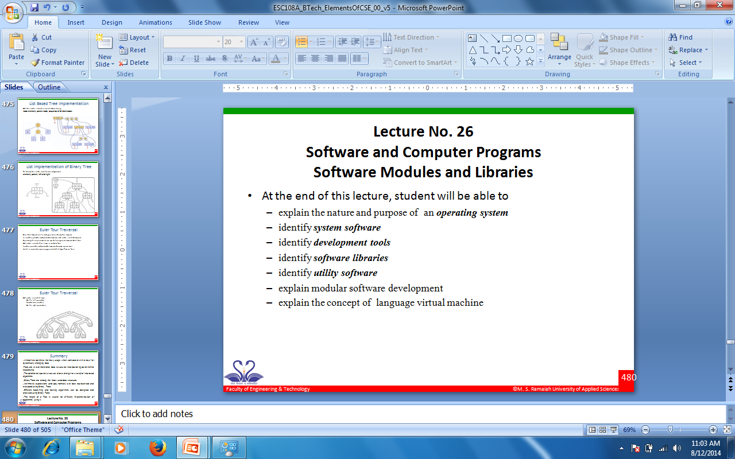
Application Software - Example

Slide 8
System Software
Which software provides an environment for the programs to run?

Slide 9
System Software contd.
Used for managing the computer hardware and provide a platform for applications to execute
System software consists of low-level programs that interact with computers at a basic level
Examples
Drivers
File system libraries
Registry
Utility software
Operating system
Runtime Libraries

Slide 10
Utility Software
Is there any software that I can use to make my system run faster?

Slide 11
Utility Software
Software that is used to analyse, configure, optimise and maintain the computer system
Disk and File System management Tools
Antivirus
Firewall
Also a System Software

Slide 12
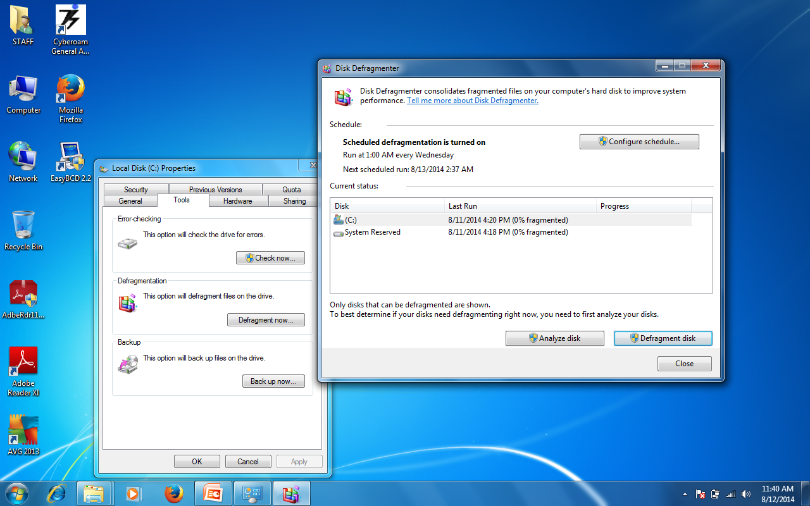
Utility Software - Example

Slide 13
Software Libraries
Who defined print?

Slide 14
Software Libraries
Provide functions
Used by many executables
Reduces code, increases reuse
DLLs in Windows
SO in Linux

Slide 15
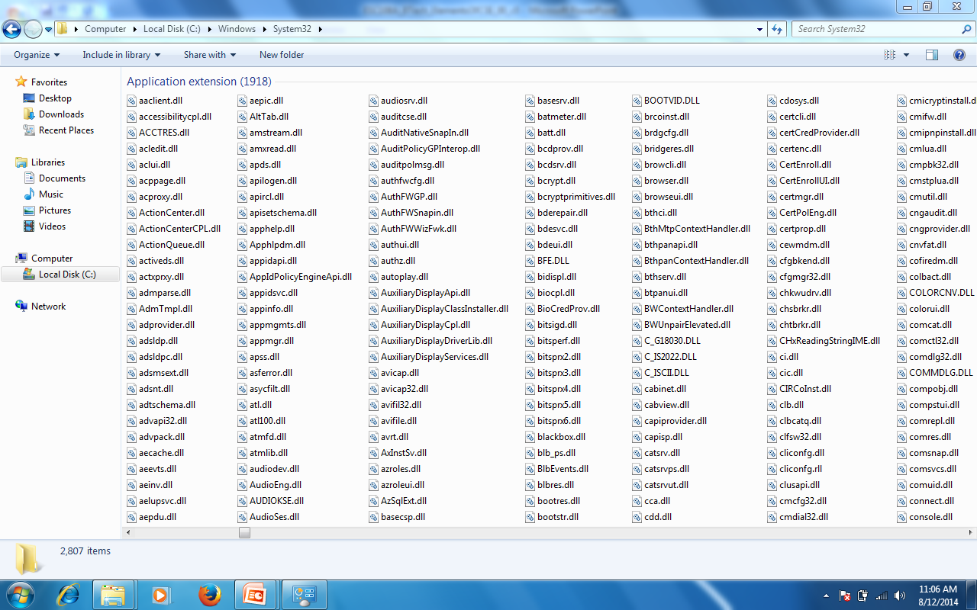
Software Libraries - Example

Slide 16
Summary
Computer software is divided in to two types
Application Software
System software
Application software are the software used by the user
System software manages the computer system and provides platform for applications to execute

